Slide 1
Financial Management in the CACFP
Sponsor of Centers

Slide 2
Agenda
Performance Standards
Budget
Allowable vs. Unallowable Cost
Maintain Financial Documentation
Notes:
Today, we will discuss the following: Today, we will discuss the following:
Performance Standards in the CACFP, Budget, Allowable vs. Unallowable CACFP Cost and how to maintain Financial Documentation in the CACFP
Performance Standards in the CACFP, Budget, Allowable vs. Unallowable CACFP Cost and how to maintain Financial Documentation in the CACFP

Slide 3
Performance Standards
Performance Standards
Financial Viability and Management
Administrative Capability
Program Accountability
Adequate resources to operate the CACFP without interruption as well as financial tracking
Notes:
There are three Performance Standards in the CACFP: Financial Viability and Management, Administrative Capability and Program Accountability
Financial Viability and Management
There should be adequate resources to sustain the program during any interruption, the institution should be able to document its finances and the submitted budget contains costs that are necessary, reasonable, allowable and documented.
Does the institution already have sufficient enrollment of children to support the expenses it has included in its budget? If not, has the State agency judged it a reasonable expectation that the institution will be able to do so?
Has the institution correctly determined the amount of reimbursement it is likely to receive on a monthly basis (number of children identified or estimated to be eligible for free, reduced-price or paid meals multiplied by the number of meals it expects to claim)?
Has the institution identified the numerous expenses of operating a business beyond those of food service; such as, property taxes and insurance, salaries, licensing and building maintenance, and childcare supplies? Again, the State agency can use this information to determine if the organization has the skills and information needed to maintain a financially viable child care institution.

Slide 4
Annual CACFP Budget

Slide 5
Annual Budget Process
Estimate reimbursements
  Start with last year’s budget
    Review actual costs
  Make realistic cost projections
    Estimate labor costs
    Estimate general administrative costs
Determine Estimated Cost
  How CACFP funds will be spent
  Funding sources that will be used if CACFP does not cover all of your costs
  Costs not included in budget are not allowable
Notes:
Determine your estimated reimbursement by looking at last years budget and making realistic projections
Determine what you will spend your CACFP funds on and what funding sources you will use to cover your remaining costs

Slide 6
Annual Budget Process
Guiding principles:
  Is the item or service necessary?
    Benefits eligible CACFP participants?
    Supports food service operations?
    Required for CACFP compliance?
  Is the amount reasonable?
  Is it an allowable expense?
*See “Financial Management: Child and Adult Care Food Program” (FNS 796-2 rev. 4)

Slide 7

Reasonable and Allowable Example
A sponsoring organization wants to change their menu and meal counting system so that it’s electronic-based. They purchase tablets for their centers for the teachers to use for all of their day-to-day activities and download the meal counting software onto each tablet. Is this a reasonable action?
Yes
Would this be an indirect or direct cost allocation to the CACFP?
If charging the internet bill, it needs to be allocated since tablet used for non-CACFP activities as well.
If charging for sole purchase and maintenance of the meal counting software, it’s a direct cost to the CACFP.

Slide 8
Administrative Costs
Sponsors may retain up to 15 percent of the CACFP reimbursement to cover program-related administrative costs.
*The State Agency may approve sponsors for less than 15 percent based on the budget review.

Slide 9
Administrative Costs: A Closer Look
Administrative labor
  Time spent on paperwork, training, monitoring, etc.
    How did last year go?
    How much time was really spent on these duties?
Notes:
-Homes estimate
-How did last year go? How much time was really spent?

Slide 10
Administrative Costs: A Closer Look
Administrative supplies & activities
  Services (accountants/storage)
  Rental and Lease Costs
  Depreciation/Use Allowance
  Equipment Costs
  Travel Costs
  Communications Costs
  Materials and Supplies
  Publication, Printing and Reproduction Costs
  Advertising and Public Relations Costs
  Provider training and support costs
  Meetings and Conferences
  Memberships, Subscriptions and Professional Org. Activities
  Insurance
  Purchased Services
  Facility Space and Costs
  Miscellaneous Costs
Notes:
Administrative supplies
Paper for CACFP records
Ink to print CACFP records
Computer hardware or software

Slide 11
Allocations
Allocations are needed if the cost:
  Benefits allowable and unallowable activities
  Benefits both CACFP and other program areas
  Benefits CACFP operations in multiple states
Must determine whether a cost is direct or indirect (overhead)

Slide 12
Allocations
Indirect cost: Cost of items or services that have a common purpose to support overall operations and cannot be readily assigned to a specific program or funding source
  Must be based on plan pre-approved by the State Agency
  Must be approved by USDA Food & Nutrition Service
Direct cost: Cost of items or services that can be identified with a specific program or funding source
  Must be based on use or benefit
  Must be pre-approved by the State Agency

Slide 13
Labor Allocations
Only the share of the wages and employer costs associated with CACFP-related labor may be paid with CACFP funds
Time distribution reports are required if
  An allocation is required and
  CACFP reimbursements will be used to pay for all or part of the employee’s allowable wages or benefits.
  Semi Annual Certification (employees who spend 100% of time on CACFP duties)
Labor Worksheet
Required if paying staff with CACFP funds
Must include all employees paid from CACFP
Must reflect realistic hours per week on CACFP duties

Slide 14
Labor Allocations
Time distribution reports must be:
  Done by the employee
  Complete
    Account for all activity (not just CACFP labor)
  Filled out after the fact
    Show actual time spent on various duties
  Prepared at least monthly
  Signed by the employee
  Signed by the employee’s supervisor

Slide 15
Budget Narrative
The Budget Narrative is the justification of ‘how’ and/or ‘why’ a line item helps to meet the program deliverables
The narrative serves two purposes: it explains how the costs were estimated and it justifies the need for the costs.
Example
  Food Service Labor:
    Center Director- Currently oversees the CACFP program at the center and will spend 20 hours per week on CACFP duties which include submitting claims for CACFP reimbursements, validating meal counts and attendance and supervising and training staff with CACFP duties. This individual earns $16.00 per hour, works total of 1020 hours per year, annual CACFP related salary: $16,320.00
Notes:
The Budget Narrative is a required part of the management plan for a sponsoring organization.

Slide 16
Documentation and Tracking

Slide 17
Documentation
Procurement documents and contracts
Itemized receipts and invoices
  Delivery slips
Labor costs:
  Payroll records
  Time distribution reports (if needed)
Documentation to support allocations, such as:
  Mileage logs for gasoline
  Floor plan and lease/mortgage documents for building space

Slide 18
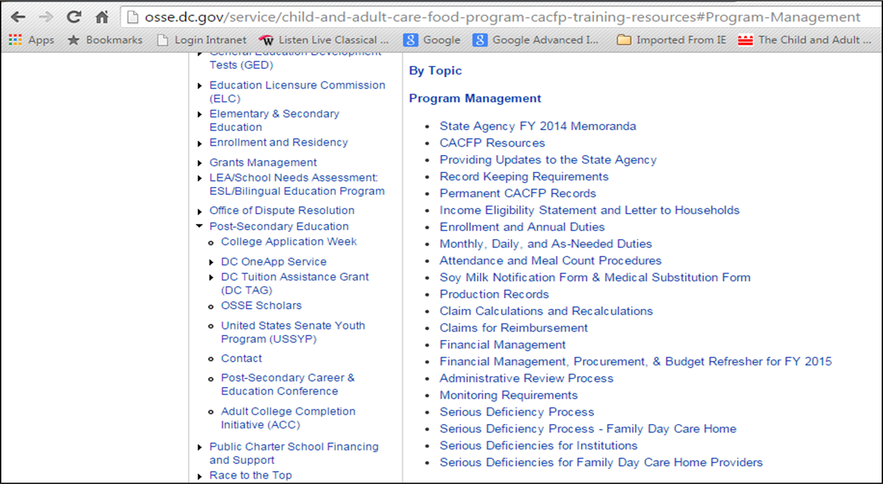
Financial Management Resources
Notes:
Osse.dc.gov/-”Training Resources” under resources for current CACFP participants

Slide 19
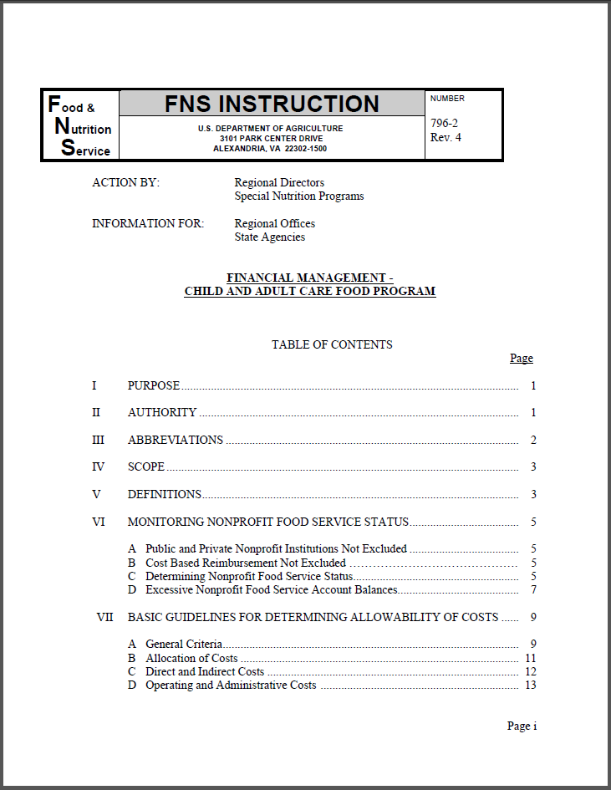
Financial Management Resources
Notes:
Osse.dc.gov/-”Training Resources” under resources for current CACFP participants

Slide 20
Thank you

