Slide 1
Financial Management in the CACFP
Independent Centers

Slide 2
Agenda
Performance Standards
Budget
Allowable vs. Unallowable Cost
Maintain Financial Documentation
Notes:
Today, we will discuss the following:
Performance Standards in the CACFP, Budget, Allowable vs. Unallowable CACFP Cost and how to maintain Financial Documentation in the CACFP

Slide 3
Performance Standards
Performance Standards
Financial Viability and Management
Administrative Capability
Program Accountability
A new or participating institution must be financially viable
The new institution must be capable of administering the CACFP
New and participating institutions must have internal controls and other management systems in place to guarantee fiscal accountability and other CACFP operational requirements
Notes:
There are three Performance Standards in the CACFP: Financial Viability and Management, Administrative Capability and Program Accountability
Financial Viability and Management
There should be adequate resources to sustain the program during any interruption, the institution should be able to document its finances and the submitted budget contains costs that are necessary, reasonable, allowable and documented.
Administrative Capability
There should be appropriate and effective management practices in place to ensure CACFP-compliant operations, adequate number of staff to run the program and written polices and procedures in place
Program Accountability
There should be a board of directors, fiscal accountability, recordkeeping systems, and compliant meal service operations

Slide 4
Developing Your Budget

Slide 5
Annual Budget Process
Determine Estimated Reimbursement
  Start with last year’s budget
  Review actual costs
  Make realistic cost projections
Determine Estimated Cost
  How CACFP funds will be spent
  Funding sources to cover remaining costs
Notes:
Determine your estimated reimbursement by looking at last years budget and making realistic projections
Determine what you will spend your CACFP funds on and what funding sources you will use to cover your remaining costs

Slide 6
Is it an Allowable Cost?
CACFP funds may be used to pay for expenditures that meet FNS’s definition of allowable, are reasonable and necessary, and have State agency approval
Allowable
  When it meets the guidelines of Food and Nutrition Service Instruction 796-2, Rev. 4
Necessary and Reasonable
  Generally recognized as ordinary
  Required for the institution to operate the Program,
  Accomplished as part of operating the Program according to regulatory requirements
Notes:
CACFP funds may only be used toward costs that are allowable, reasonable and necessary. An allowable cost must meet the guidelines of FNS Instruction 796-2, Rev. 4
Necessity is determined by the nature of the activity, while reasonableness is determined by the amount of the cost

Slide 7

Necessary and Reasonable Example
An independent center cooks food from scratch. The old oven is no longer working and is not repairable so the center purchased a new oven to cook meals for the children. Is this a reasonable action?
This would be a reasonable action. However, if the oven costs $3300 and the center serves 15 children, this expense is not reasonable.

Slide 8
Additional Requirements for Allowable Cost
Legal under state and local law
Conform with Federal Regulations
Consistent Treatment
Applicable Credits
Adequate Documentation
Prior Approval
Notes:
Legal under State and Local Law- In order to be allowable, the cost must be authorized or at least not prohibited under Federal, State or local laws and regulations.
Conform with Federal Regulations- The cost must conform to limits or exclusions, as set forth in FNS Instruction 796-2, Rev. 4 and Federal laws, or other governing regulations. If a cost is prohibited by the IRS, it cannot be allowed in CACFP.
Consistent Treatment- The cost must be treated consistently through the application of U.S. GAAP principles. This means the same cost cannot be charged differently depending on the Program to which it is assigned
Applicable Credits- The cost must be net of all applicable credits. Only the actual cost to the institution can be claimed; any purchase discounts, rebates, or allowances received, must be credited to the CACFP either as a cost reduction or by cash refund
Adequate Documentation- All costs charged to the CACFP must be properly documented with receipts, invoices, or mileage logs, and time and attendance records
Prior Approval- All costs require prior approval before they can be incurred – that is, obtaining the State agency’s or FNS’ written permission ahead of the expenditure is required.

Slide 9
Direct Cost and Indirect Cost Plans
Direct Cost
  Costs that can be easily identified directly to, and only to, the CACFP
    Exp: Food service employee salaries when their only function is to prepare CACFP participants’ meals
Indirect Cost
  Cost that are incurred for both CACFP operations and non-CACFP activities in which the institution may be involved
    Exp: the cost of water and utilities that are on a shared meter for both the institution’s CACFP and its non-CACFP activities
Notes:
Some costs are easy to identify as directly attributable to the CACFP meal service or administrative duties. Other costs are difficult to attribute to only CACFP activities because the costs cover non-Program activities also; these are referred to as indirect costs and require special approval.

Slide 10
Allocations
Indirect cost: allocation or rate must be
– Based on plan pre-approved by the State Agency
– Approved by USDA Food & Nutrition Service
Direct Cost: Allocation must be
  Based on use or benefit
  Pre-approved by the State Agency
Notes:
Allocation is the procedure used to determine the amount or percentage of cost charged to a particular function/activity or Program, based on the benefits received, not the source of funds available to pay for the cost. The institution must provide the State agency with the method it will use to assign or allocate these shared costs.

Slide 11
Labor Allocations
Only the share of the wages and employer costs associated with CACFP-related labor may be paid with CACFP funds
Time distribution reports are required if
  An allocation is required and
  CACFP reimbursements will be used to pay for all or part of the employee’s allowable wages or benefits.
  Semi Annual Certification
Labor Worksheet
Required if paying staff with CACFP funds
Must include all employees paid from CACFP
Must have realistic hours per week on CACFP duties
Notes:
Semi annual certification is for when you have an employee that has 100% CACFP duties and are being paid with CACFP funds

Slide 12
Budget Narrative
The Budget Narrative is the justification of ‘how’ and/or ‘why’ a line item helps to meet the program deliverables
The narrative serves two purposes: it explains how the costs were estimated and it justifies the need for the cost.
Example
  Food Service Labor:
    Center Director- Currently oversees the CACFP program at the center and will spend 20 hours per week on CACFP duties which include submitting claims for CACFP reimbursements, validating meal counts and attendance and supervising and training staff with CACFP duties. This individual earns $16.00 per hour, works total of 1020 hours per year, annual CACFP related salary: $16,320.00

Slide 13
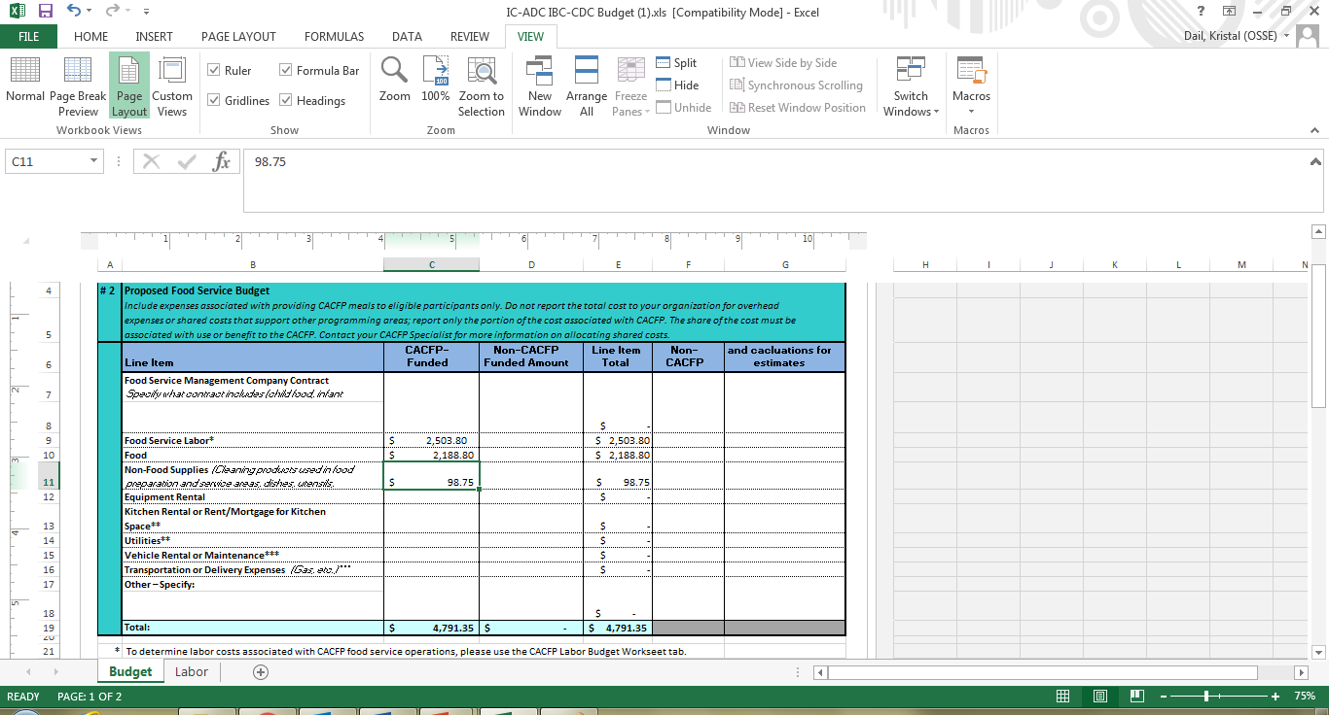
Budget Example

Slide 14
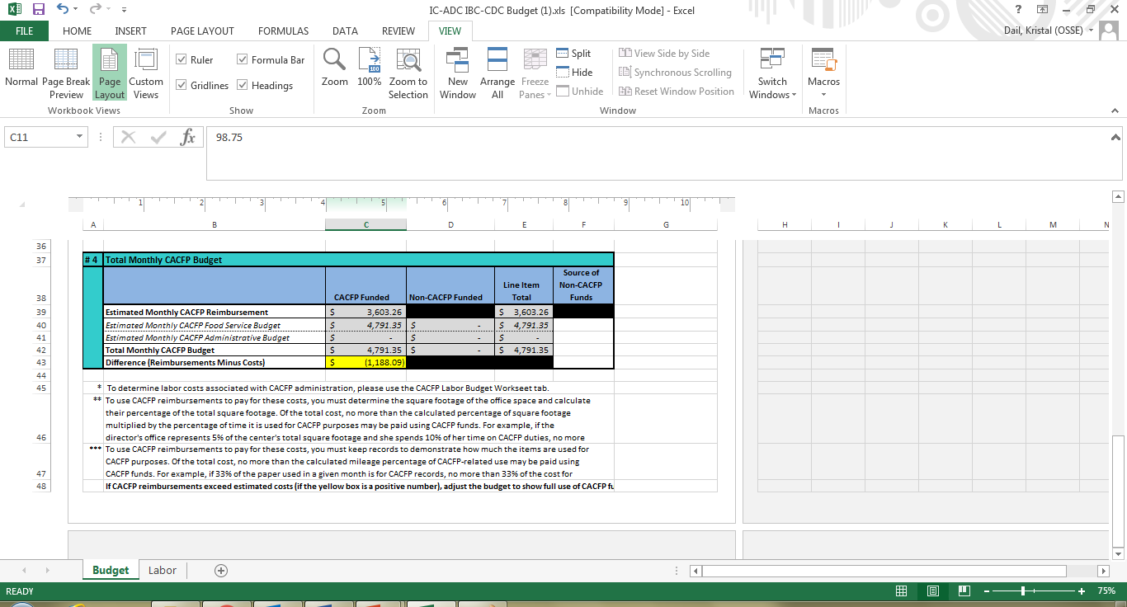
Budget Example

Slide 15
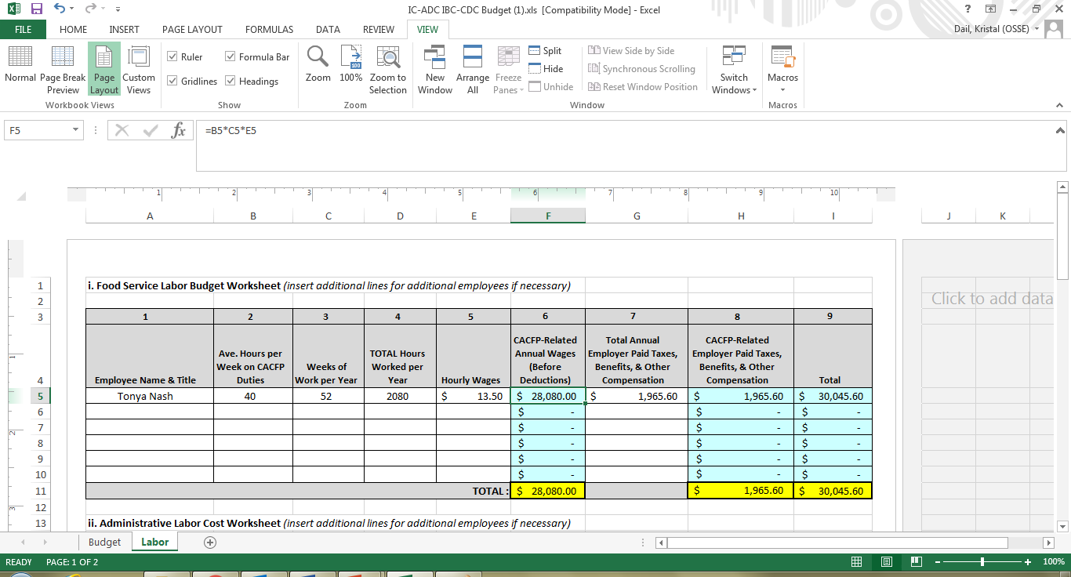
Budget Example

Slide 16
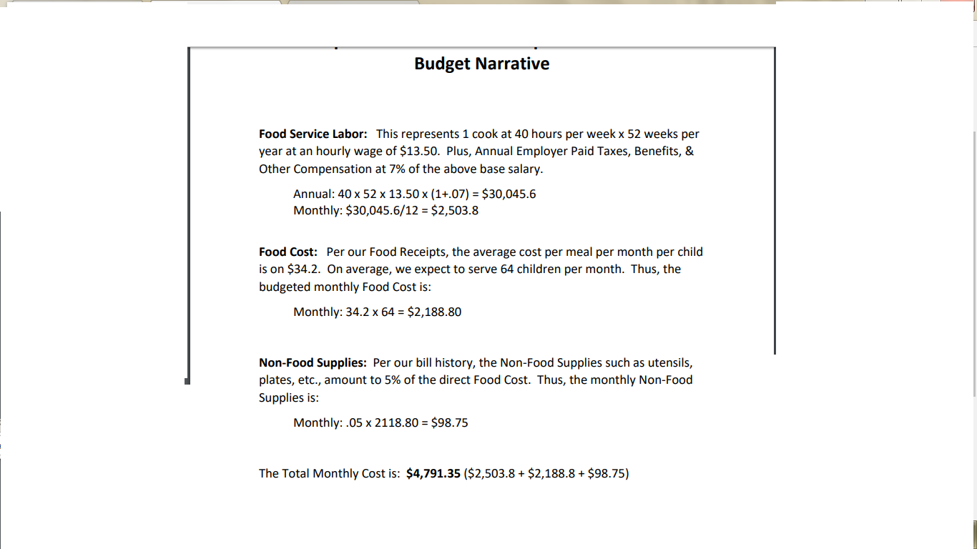
Budget Narrative Example
Notes:
This Budget Narrative supports the budget we just reviewed.

Slide 17

Budget Narrative Activity
Budget Narrative Activity
  Please develop a budget and budget narrative to support your provided budget
  Use the budget narrative example handouts to assist you

Slide 18
Maintaining Financial Documentation

Slide 19
Documentation
Procurement documents and contracts
Itemized receipts and invoices
  Delivery slips
Labor costs:
  Payroll records
  Time distribution reports (if needed)
Documentation to support allocations, such as
  Mileage logs
  Floor plan and lease/mortgage documents
Notes:
You should be procuring new FSMC contract after the initial year and the 3 years following
Document all your receipts and delivery slips from FSMC’s

Slide 20

Financial Management Best Practices
Track CACFP reimbursements
Track CACFP- related expenses
Use a financial management
spreadsheet to track your CACFP
expenses
Notes:
- The State Agency has a financial management spreadsheet and many resources you can use to help with financial management. Ask your Specialist

Slide 21
Labor Allocations
Time distribution reports must be:
  Done by the employee
  Complete
    Account for all activity (not just CACFP labor)
  Filled out after the fact
    Show actual time spent on various duties
  Prepared at least monthly
  Signed by the employee
  Signed by the employee’s supervisor

Slide 22
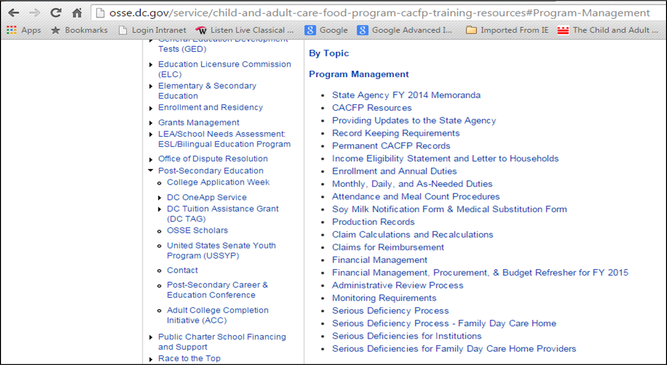
Financial Management Resources
Notes:
Osse.dc.gov/-”Training Resources” under resources for current CACFP participants

Slide 23
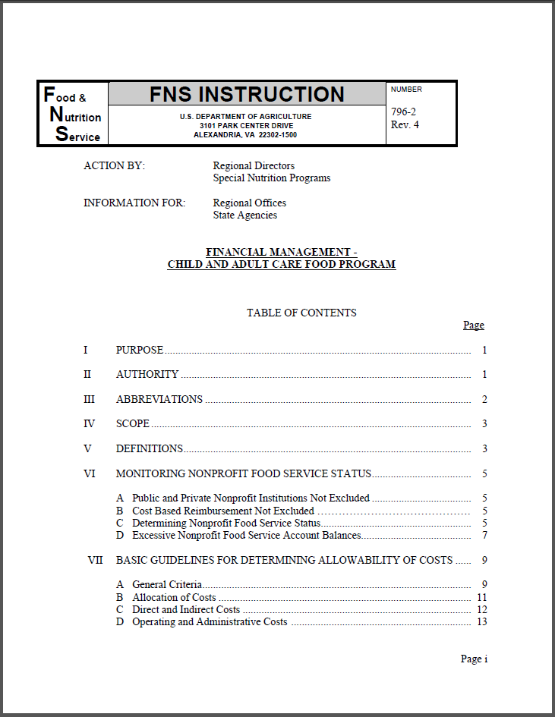
Financial Management Resources
Notes:
Osse.dc.gov/cacfp-”Food and Nutrition Service Instructions” under resources for Current CACFP Participants

